Slide 1

The History of Top 10 Richest People in the World
This presentation explores the lives and achievements of the top 10 richest individuals in the world, highlighting their entrepreneurial journeys, innovations, and contributions to various industries.

Slide 2
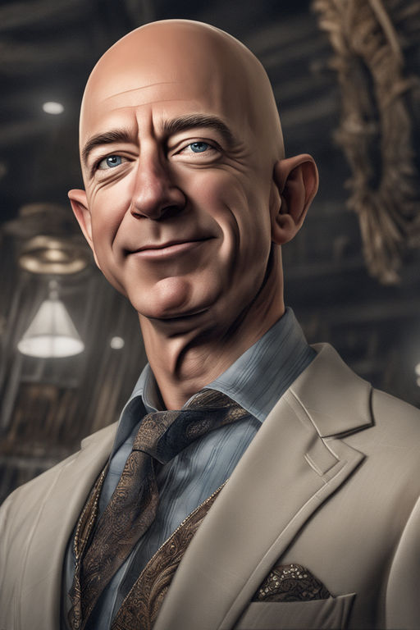
Jeff Bezos
Jeff Bezos is the founder of Amazon.com, which began as an online bookstore in 1994 and expanded into various other product categories, making Bezos one of the wealthiest individuals globally.

Slide 3
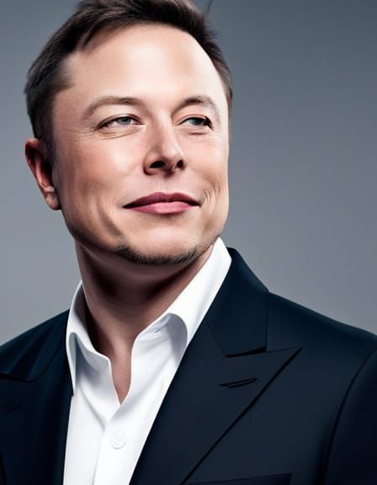
Elon Musk
Elon Musk, known for his ventures such as SpaceX, Tesla, and Neuralink, has significantly influenced the automotive, aerospace, and renewable energy industries, positioning himself as one of the richest and most innovative entrepreneurs.

Slide 4
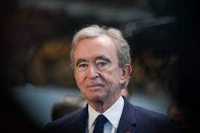
Bernard Arnault
Bernard Arnault is the chairman and CEO of LVMH Moët Hennessy – Louis Vuitton SE, leading the world's largest luxury-goods company and amassing substantial wealth in the fashion and retail sectors.

Slide 5
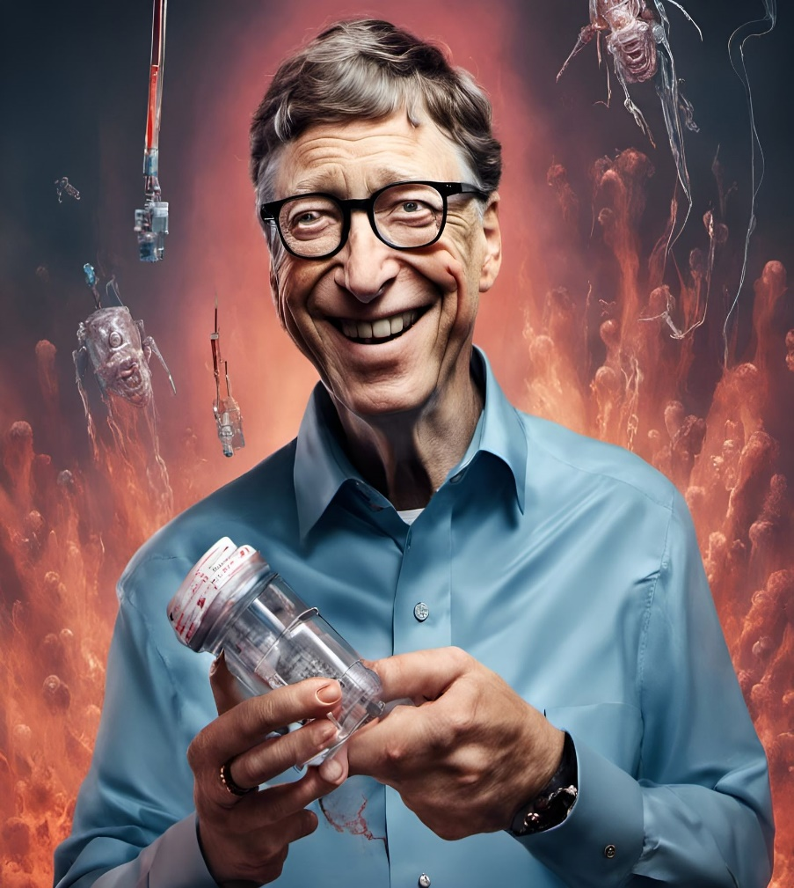
Bill Gates
Bill Gates, co-founder of Microsoft Corporation, has shaped the technology landscape through his pioneering work in software development and philanthropy, making him one of the richest and most influential figures in the world.

Slide 6
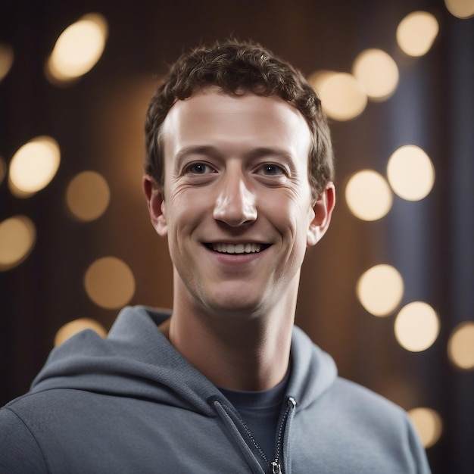
Mark Zuckerberg
Mark Zuckerberg, co-founder and CEO of Meta Platforms (formerly Facebook), has revolutionized social media and digital communication, amassing significant wealth and influence in the tech industry.

Slide 7
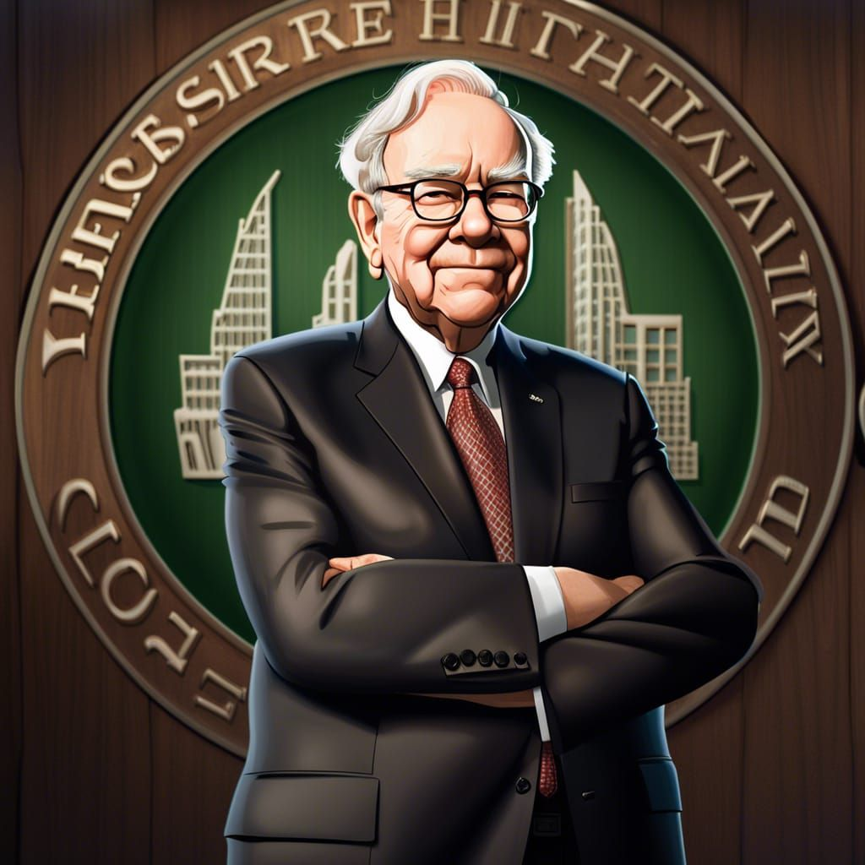
Warren Buffett
Warren Buffett, chairman and CEO of Berkshire Hathaway, is renowned for his investment prowess and business acumen, making him one of the most successful and wealthiest investors in history.

Slide 8
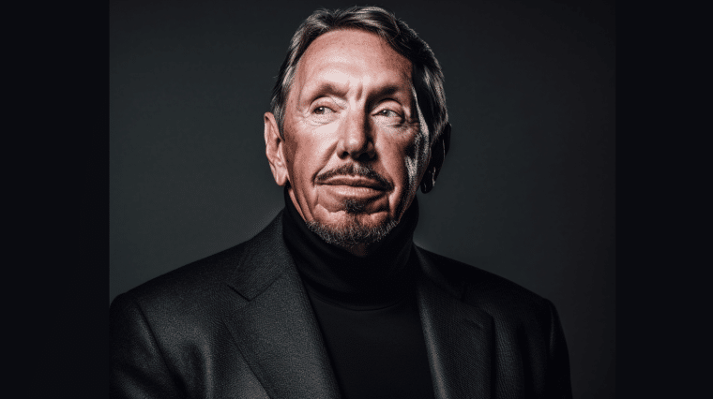
Larry Ellison
Larry Ellison, co-founder and former CEO of Oracle Corporation, has played a pivotal role in shaping the tech industry with his contributions to database software and cloud computing, accumulating substantial wealth along the way.

Slide 9
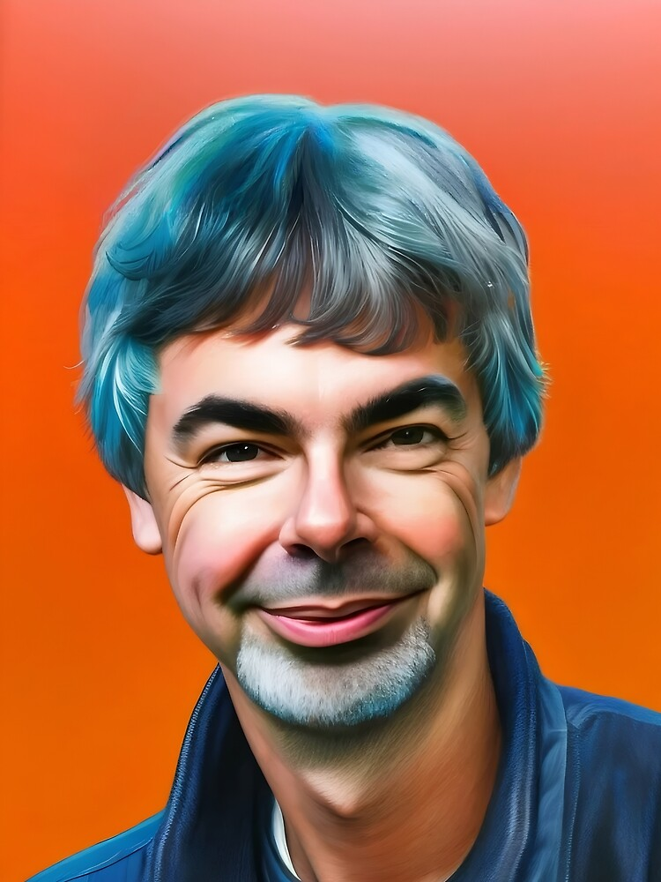
Larry Page
Larry Page, co-founder of Google and CEO of Alphabet Inc., has transformed internet search and digital advertising, solidifying his position as one of the wealthiest and most influential figures in the tech world.

Slide 10

Sergey Brin
Sergey Brin, co-founder of Google and president of Alphabet Inc., has been instrumental in innovating internet services and advancing technology, contributing to his immense wealth and impact in the tech industry.

Slide 11
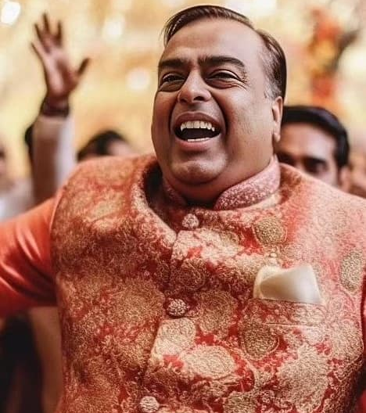
Mukesh Ambani
Mukesh Ambani, chairman and largest shareholder of Reliance Industries, has expanded his family's business into telecommunications, retail, and petrochemicals, becoming one of the richest individuals in India and globally.

